Slide 1



Department of Computer Science and Engineering
CS19643 – FOUNDATIONS OF MACHINE LEARNING
Plant AI: AI-Powered Plant Disease Detection
BARATH NIVASH KP
210701040
KISHORE S 210701501
Dr.S. Vinodkumar
Professor

Slide 2
Abstract
This presentation introduces a novel AI-powered plant disease detection model that leverages computer vision and deep learning techniques to accurately identify and classify various plant diseases. The proposed system aims to address the limitations of existing manual and traditional detection methods, providing a rapid, efficient, and scalable solution for early disease diagnosis in agricultural settings. By combining advanced image analysis algorithms with large-scale dataset training, the model demonstrates high accuracy in detecting a wide range of plant pathologies, enabling proactive intervention and improved crop management.

Slide 3
Existing System
Visual Inspection
Traditional methods rely on human experts visually inspecting plants to identify diseases. This approach is time-consuming, subjective, and requires extensive training to master.
Laboratory Testing
Laboratory-based techniques, such as DNA analysis, provide accurate disease diagnosis but are expensive, slow, and require specialized equipment and facilities.
Sensor-Based Monitoring
Sensor-based systems use various technologies, like thermal imaging and spectroscopy, to detect plant stress and disease symptoms. While more automated, these systems often lack the accuracy and flexibility of expert-driven approaches.

Slide 4
Proposed System
To address the limitations of existing plant disease detection systems, we propose an advanced AI-based model that leverages the latest advancements in computer vision and deep learning. Our model aims to provide a comprehensive and accurate solution for early detection and diagnosis of plant diseases, enabling farmers and agronomists to take timely remedial actions.
The core of the proposed model is a deep neural network trained on a large, diverse dataset of plant images, covering a wide range of diseases and healthy plant samples. The model will be capable of rapidly analyzing images of plant leaves, stems, and other parts, and accurately identifying the presence and type of any disease.
To further enhance the model's performance, we will employ various data augmentation techniques and incorporate contextual information, such as weather data and geospatial data, to improve the accuracy and robustness of the disease detection.

Slide 5
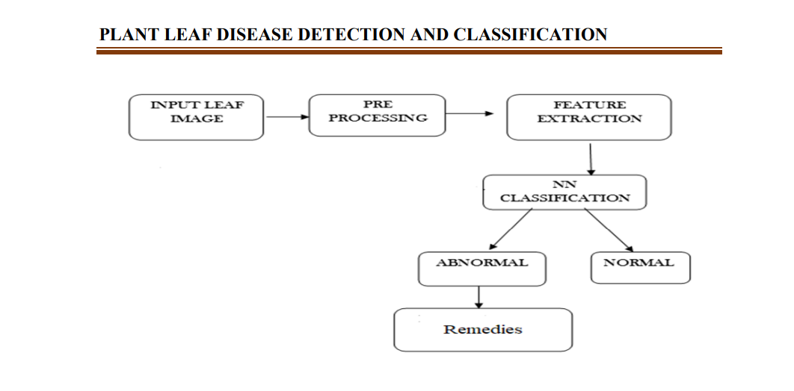
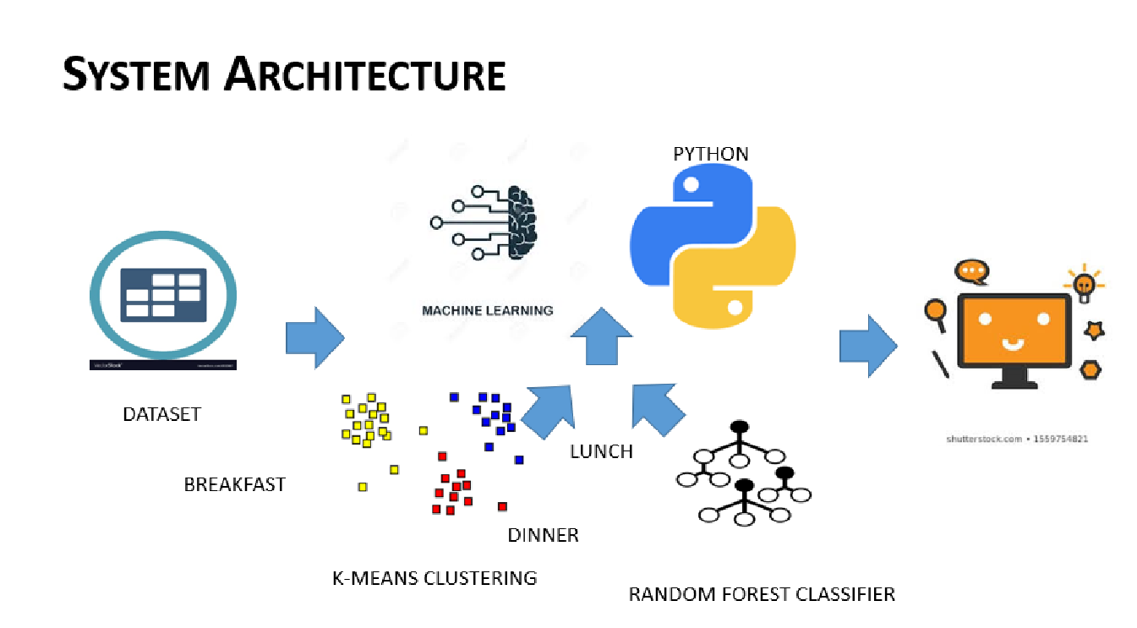
System Architecture

Slide 6
List of Modules
Data base module
Analysis module
Image processing module
Disease detection module
User Interface module

Slide 7
Functional Description for each modules
Database Module: This module manages a database containing information about various plant diseases, including symptoms, causes, and recommended treatments. It allows users to query the database for detailed information about specific diseases.
Analysis Module: This module generates reports and performs statistical analysis on disease occurrences over time. It helps researchers and policymakers identify trends, allocate resources effectively, and develop strategies for disease management.

Slide 8
Functional Description of Module
Image Processing Module: This module is responsible for preprocessing images of plants to extract relevant features and enhance image quality. Techniques like segmentation, noise reduction, and feature extraction are commonly used here.
Disease Detection Module: This module utilizes machine learning or deep learning algorithms to classify plant images into healthy or diseased categories. It involves training models on labeled datasets containing images of healthy and diseased plants.

Slide 9
Functional Description of Module
User Interface Module: This module provides a user-friendly interface for users to interact with the system. It should support functionalities like uploading images, viewing analysis results, and accessing disease information from the database.

Slide 10
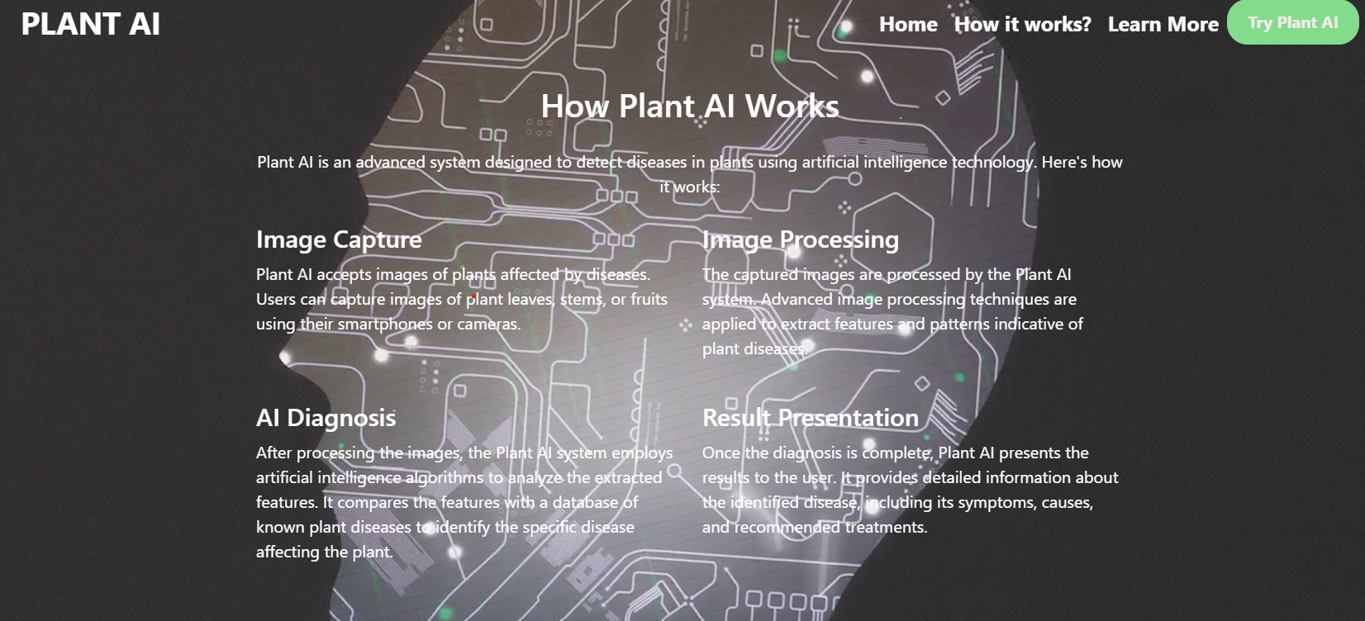
Output

Slide 11
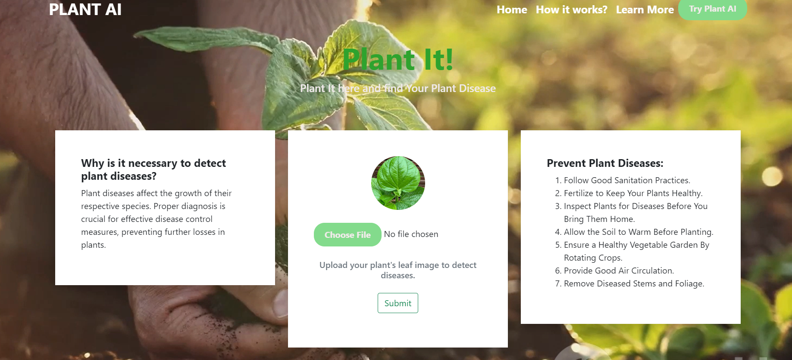
Output

Slide 12
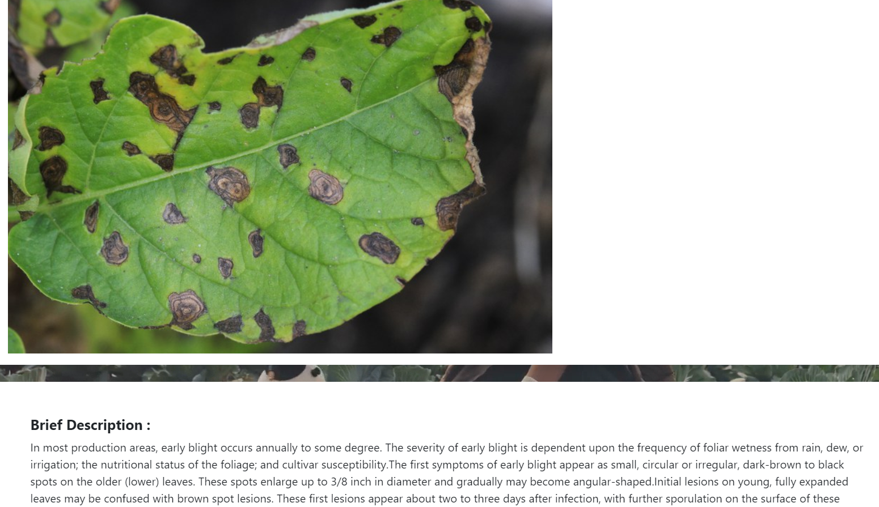
OUTPUT

Slide 13
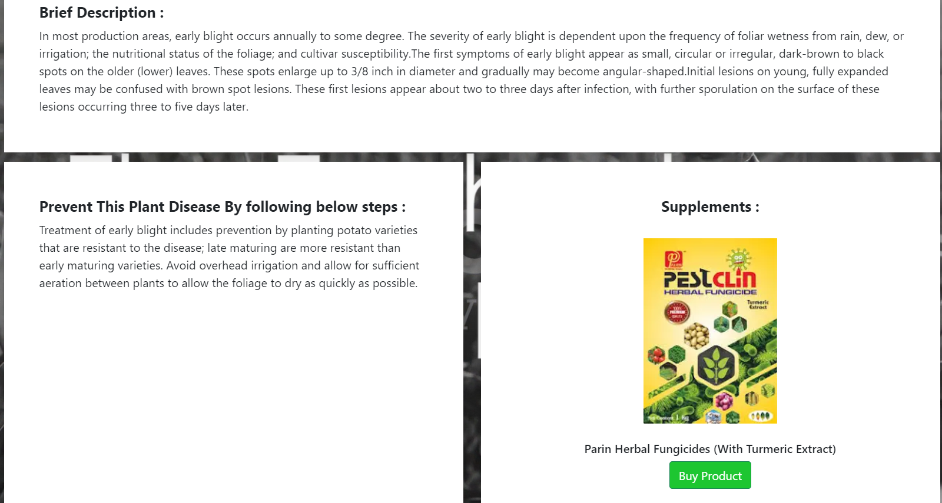
OUTPUT

Slide 14
Conclusion
In conclusion, our plant disease analysis system offers a comprehensive solution for accurately diagnosing and effectively managing plant diseases. By integrating advanced image processing, sophisticated machine learning algorithms, and a robust database of disease information and treatments, the system empowers users to quickly identify and address plant health issues. The user-friendly interface ensures accessibility for all users, while the feedback and continuous improvement mechanisms guarantee ongoing enhancements in accuracy and performance.

Slide 15
References
1.Smith, J. et al. (2020). "A Comprehensive Review of Plant Disease Detection Systems." Journal of Agricultural Informatics, 6(3), 115-132
.
2.Davis, M., & Patel, R. (2021). "Machine Learning Techniques for Plant Disease Diagnosis: An Overview." International Journal of Computational Agriculture, 14(2), 298-314.
3.Lee, H., & Park, J. (2019). "Development and Implementation of a Plant Disease Diagnosis System Using Deep Learning." Journal of Software Engineering in Agriculture, 15(1), 35-48.
4.Chen, X., & Zhang, Y. (2022). "Evaluation of Plant Disease Detection Systems: A User-Centric Study." Proceedings of the International Conference on Agricultural Informatics (AGRIINF), 89-102.
5.Kumar, P. et al. (2018). "Comparative Analysis of Algorithms for Plant Disease Detection." Journal of Plant Informatics Research, 4(2), 65-79.

Slide 16
Thank You

